Slide 1



A Taste of Research:
Preparing and Presenting a Poster
Workshop 1
Presented by Pam Mort,, Gwyn Jones , Graeme Bushell,.
http://www.lc.unsw.edu.au
UNSW students may download a single copy for individual study purposes. UNSW staff may also use the resource for teaching purposes.. If educators or institutions not part of UNSW would like to use the resource in their own courses, written permission is required. Please contact Pam Mort (p.mort@unsw.edu.au ) for permission and feedback
Notes:
Introduce self- why we are here – request from faculty-
aims of today's workshop: 1. understand the purpose of a poster, 2. understand what makes an effective poster
Outcome: begin designing your poster
Activities: some chat – critiquing sample past posters, forming the key message of your poster
Poster purpose: to present an overview of your research project – the poster should clearly communicate what you did, why you did it, and what you achieved – the poster should be able to ‘stand alone’ . Key weaknesses in posters are: lack of clarity about rationale ( why do this ? Who cares?), lack of clear findings ( what do you know for certain? What questions remain ? What re you most proud of?), text and visuals competing rather than complementing each other ( too much information that creates confusion not clarity)
Problems with presentations include; lack of preparation – evident by just repeating/reading what is on poster and not referring to poster during presentation (Note; more on this second workshop) .

Slide 2


The Researcher
What does selling your engineering research mean to you?
Notes:
Review the concept of being a researcher and moving form the role of the “student” to that of the very pro active , researcher! Ask about the student’s experience with it so far. Discuss. Clicl- What questions have they come up with so far and click how are they going to sell there work? The poster is one style expected in their community of practice. Blah..blah..bah..

Slide 3
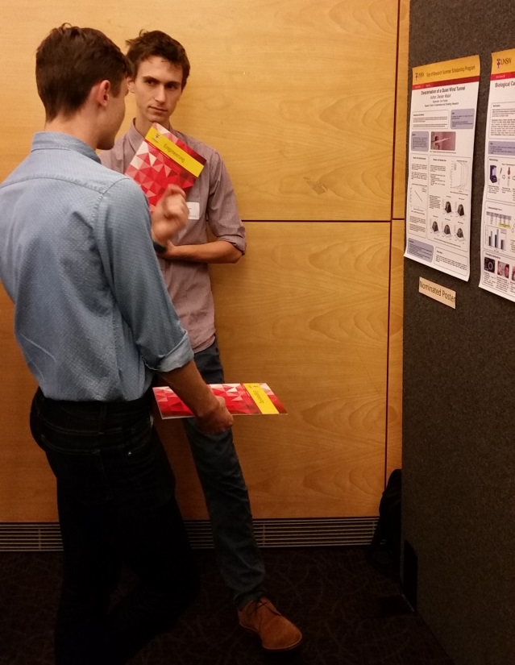
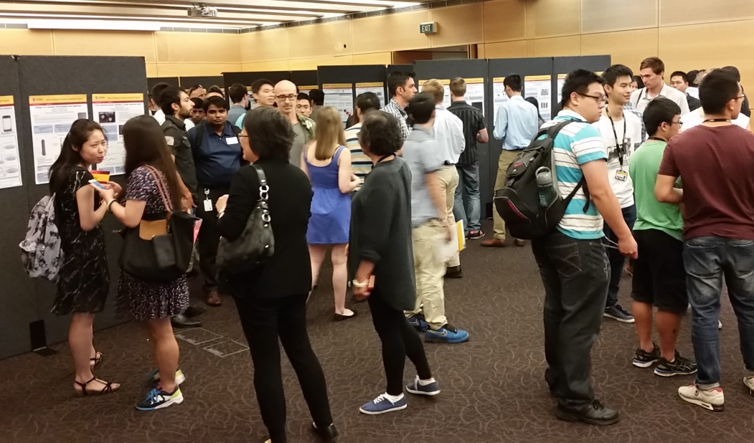
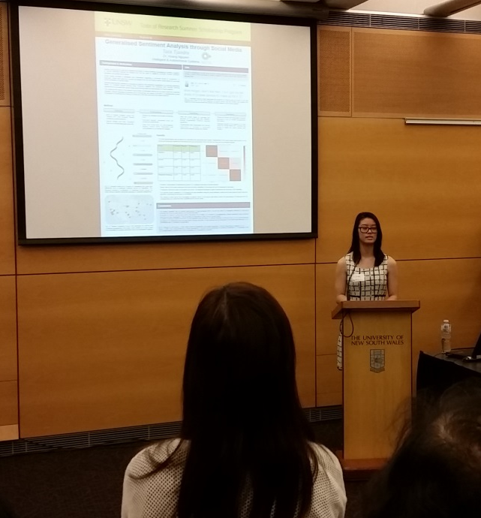
Why Posters?
Notes:
Staff explain how posters are part of academic communication in their discipline and share their experiences of poster presentations ..

Slide 4
Important dates and activities !
Wed 16 Jan- Workshop 1 – Poster Design
Outline the requirements of good poster design
Wed 23 JanWorkshop 2- Presenting your Research
Peer feedback on draft posters + practice talking about your research
Monday 28 January– Posters submitted – More instructions in early Feb ( Ask Alman) .
Tue 5 Feb - School Poster Presentation
Academic staff and TOR students choose 3 best poster presentations to represent the school/group. 2.30pm onwards - venues tbc
Friday 8 Feb- Faculty Poster Presentation
Presentations + certificates given - Industry partners will attend
12.00 – 2.00pm in the Galleries room

Slide 5

Poster Preparation
Allow 7 days –breakdown tasks & time
Follow the template instructions
Prepare drafts- print sections
Check information and visuals for: sequence, quantity, flow, style,
Change - reprint sections
Write a 2 minute speech (200 words) W,W,H,SW!
Practice with your poster- refer to visuals- elaborate briefly
Notes:
These bullet points will come in one at a time –what’s required to get the job done and to do it well- this is a list of the process and tasks required to complete a poster – a reality check for managing the task.

Slide 6
Poster sections
Title , author, supervisor, research theme
Background/Motivation –2 sentences to 2 paragraphs + visual (why we should care)
Aim/s – 1 to 3 sentences (your task/s)
Methods and Results – visuals & text – 70% of poster (what was done and found)
Conclusions- key findings and outcomes – 2 to 5 sentences/points (what this means )
Notes:
These guidelines are based on analysis of past posters. And the guidelines for the assignment.
Background-Note; usually for research that is multidisciplinary eg biology and mechanical engineering- more background ( explanation) is required than for more ‘traditional’ engineering research.
Conclusions should be clearly stated- give specific outcomes and findings – avoid vague generalizations.

Slide 7
The poster should:
have a clear message (2 mins max!)
present information clearly & logically
be visually pleasing to look at
be well constructed and look professional
Notes:
What the poster is meant to achieve .. More on how later

Slide 8
To present information clearly & logically
Arrange text/visual items how most people read
Have an informative title and subheadings
Keep text to a minimum –use bullet points & short paragraphs
Use visuals for key information - not for decoration
Use plain English
Notes:
Some tips : Most people read left to right and top to bottom.
Title and subheadings are used to navigate the sections of the poster and help create cohesion between sections- text style in posters is very concise - you will need to rewrite text a number of times-
Also be aware that engineers tend to look at images first and then check text to see if they understand. So visuals are very important.
Plain English is not dumbing it down- it is a way of constructing sentences and using language so that information and meaning is clear (more on this later)

Slide 9
Critique two posters
Poster A (organic pollutants) & poster B (smart polymers)
How well do the posters conform to the checklist? (work in pairs and use handout)
To see more posters : https://www.engineering.unsw.edu.au/study-with-us/scholarships/taste-of-research-undergraduate-scholarships/sample-posters
Notes:
Colour handouts- 1 pair per 2 students plus checklist- – students use checklist to critique poster- summary from group/s – add you own thoughts - what you like about the poster- what works well, also tell them where you think posters could be improved.

Slide 10
To have a clear message- Part 1
Consider the types of titles and subheadings
Indicative- state topic + approach
Declarative- make claim – finding/outcome
Hanging- use colon (:) to break up long titles
Question (make sure you put the answer in the poster!) – rarely used
Notes:
At this point you can direct students to the poster checklist- these slides will add more tips and help explain the checklist.
Most common title is indicative followed by hanging-( hanging usually moves from general topic/problem to specific topic/focus of the research) declarative titles are becoming more common – question titles are rare and in some journals not allowed- avoid

Slide 11
‘The Title’
Gap-Crossing Decisions by Red Squirrels in Fragmented Forests
Hunger, Detour Length, & Highly Defended Territories Influence Red Squirrel Movement in Fragmented Forests
Mammal Movement in Fragmented Forests: Red Squirrels Gap-Crossing Decisions.
What Factors Influence Red Squirrel Movement in Fragmented Forests?
Indicative
Declarative
Hanging - Indicative
Question
Notes:
Here are examples of a poster title in different title styles- which do you prefer ? When you write your tile, draft different types of titles and ask your colleagues which is the most engaging title to use in your poster.

Slide 12
Which is a better title and why?
Towards Holographic Data Storage: Polymer Dispersed Liquid Crystals and Its Applications
Single phase digital power meter
Digital Signal Processing for Human Genome Sequencing
Aim + topic
Topic
Approach + topic
Notes:
I think the third is best -we have some idea the purpose or application of the research- it gets our interest and focuses our thoughts - second title is just a topic – we have no idea what is the focus of the topic ( it’s like having a poster that says ‘ the environment’ – too broad and general) Note that first title has error in singular use of ‘its’ should be plural ‘their’ ??? while it does give the topic area and application – it seems a bit repetitive? Could just say ‘ Polymer dispersed liquid crystals for holographic data storage’ ?

Slide 13
A clear message: Part 2
Keep poster text to a minimum (250-400 words)
This research project investigated the many factors that appeared to have influenced Red Squirrels when deciding to cross a gap in a fragmented forest. (24 words)
Aim:
to identify factors that influence Red Squirrel decisions to cross gaps in fragmented forests
(15 words)
Essential information only
Notes:
This is an example of how to reduce words so that your text is concise and so that key information is obvious – easily understood –In a poster you can use headings and bullet points to good effect. Note do not write reports in poster style!

Slide 14
A clear message: Part 3
“A picture is worth a thousand words”
(source unknown)
Caption and image make a clear message
Visuals- Easy to ‘read’ & stand alone
Use white space - ‘mental pause’
Place visual near to relevant text
Notes:
Some things to think about – danger of too many visuals – need a balance of text and visuals- use your best visuals- ask your self- what message is in this visual? Is this the best visual to communicate this message ? Do I have a better visual or would a short clear sentence be sufficient?

Slide 15
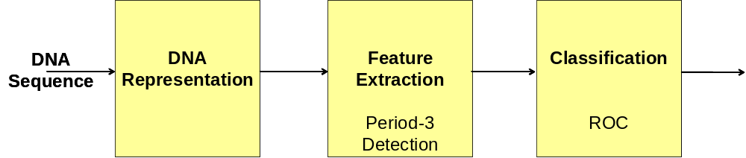
Genomic Signal Processing
Methodology
The generalised methodology for genomic signal processing involves three steps as shown below.
Notes:
This is a good use of text and visual- gives an overview of the research approach – clear and simple! Block diagrams of approach/method are acceptable in engineering

Slide 16
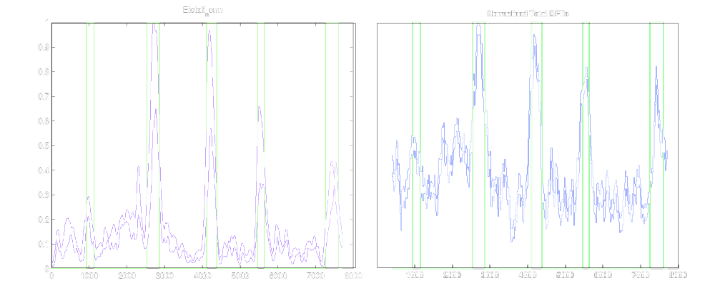
Results
The results for the C. Elegans sequence using the proposed method and the DFT are presented below. The green peaks are the actual genic/coding regions and the blue peaks are the extracted features.
Wavelet Packet Decomposition DFT
Notes:
This is ok- second sentence is the legend/key – see next slide for how to use legend/key- figures should be labeled and referred to properly from text…follow standard conventions for figures as you would with written reports - DFT abbreviation – make sure it is in full earlier in the text when first mentioned.

Slide 17
Results
The results for the C. Elegans sequence using the proposed method and the DFT are presented in figures 3 and 4.
Figure 3.Wavelet Packet Decomposition Figure 4. DFT
Genic/coding region
Extracted features
Notes:
Now the reader can refer to the key and the visual more easily- remember that most engineers will look at visual first and then text to check understanding . Place visuals AFTER text where they are mentioned

Slide 18
A clear message: Part 4
Use Plain Formal English
No slang (kid/child)
Eliminate formal/old fashioned and redundant words/phrases (eg: erstwhile/former, at this point in time/currently)
Avoid really large noun groups (eg; Percentage transmission recording ultraviolet light absorption meter)
Use active voice where appropriate
(eg: Squirrels avoided… / Forested routes were avoided by..)
Put the most important information first i.e. main clause (eg; We can reduce expenditure by streaming stage 1 operations.)
Notes:
Plain English is not dumb English- it is about clarity of the message- about making a reader friendly text – these tips will ensure you create a clear and concise text

Slide 19
Original text
The proposed method was compared with several other more established methods (including the DFT) all of which were then classified using Receiver Operating Characteristic (ROC) curves. ROC curves consider many thresholds to make coding/non-coding decisions. The results of which are then plotted to produce:
(45 words)
Eliminate redundant words
The proposed method was compared with several established methods (including the DFT). All results were classified using Receiver Operating Characteristic (ROC) curves. ROC curves consider many thresholds to make coding/non-coding decisions. These results were plotted (figures 5 and 6).(40 words)
Be precise and clear (*rewritten by head of school EE)
Using Receiver Operating Characteristic (ROC) curves, the proposed method was compared with established methods (including DFT) , as shown in figures 5 and 6. ROC curves make coding/non-coding decisions by considering a number of threshold levels. (35 words)
Notes:
Here is an example of rewriting a text to ensure the essential information is communicated clearly First we try to eliminate repetition and redundant words ( red underline) , then we consider the logical order to the information –the outcome is a much more concise text – and hopefully clearer! So remember… you will have to create a number of drafts of your poster text- get a friend to read your different version to see which is most clear

Slide 20
Design
Colours- Choose 2/3 harmonious and 1 contrast
Overall design –2 columns max, read from top to bottom and left to right,
Text - logical sequence of sections, integrate text + visuals.
Notes:
Some things to remember about design

Slide 21

Colour
Red text on blue background
Yellow text on orange background
Dark blue on white background
Dark blue on light green background
Notes:
Which is easier to read? High contracst is needed – tip print / view your poster in grey sale .. Are my text and visuals still clear ?

Slide 22
Presenting the Poster
Look tidy – smart casual
Ensure poster is displayed
Refer (briefly) to the poster during your presentation
Avoid reading a prepared script
…more on this next week…

Slide 23
Activity 2: Clarifying the message
Write the title of your project/poster!
Write the problem/rationale of the project
Write the aim of your project/poster
What single thought do you want the reader to retain? (and ..What are you most proud of in your project?)
In your groups, discuss your title, aim & message.

Slide 24
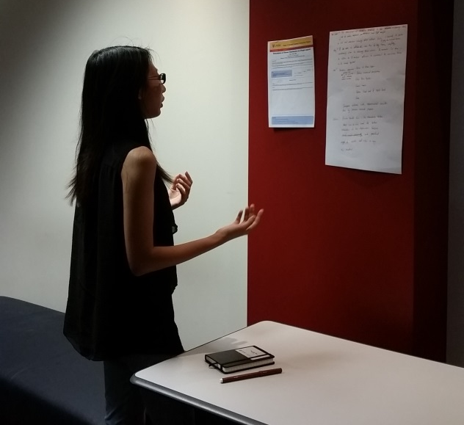
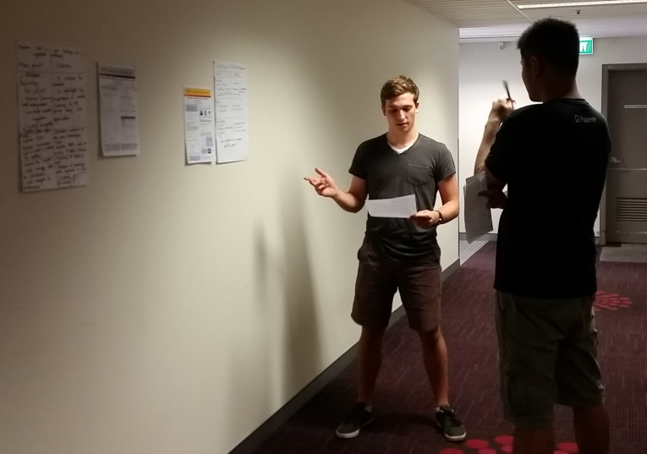
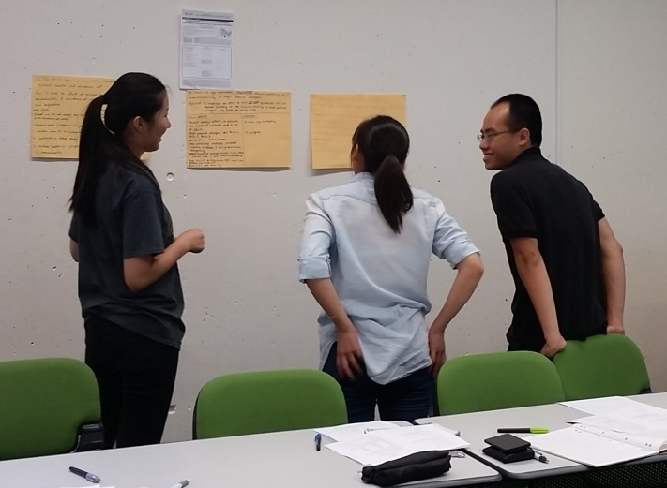
HOMEWORK!
Prepare a draft poster and your draft script-
    bring draft poster elements (text and visuals on A4 pages) to next workshop
    Refer to the handout for preparing a draft script
    Bring your presentation and be prepared to “sell” your research!

